Slide 1
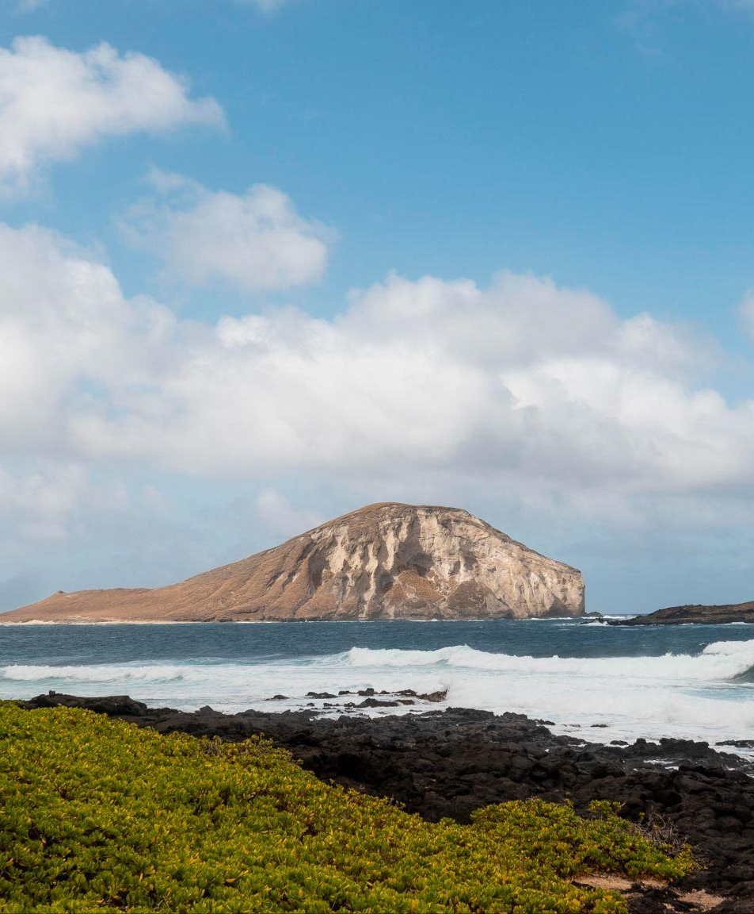
VISIT Safirni
Safirni it’s and travling website

Slide 2
TABLE OF CONTENTS
01
02
03
04
05
06
About safirni
Our goals
Home
What’s Safirni is
What we expect safirni to do
Describe the topic
of the section here
About us
countries
Login and reg

Slide 3


OUR COMPANY
We strive to provide advice on how to plan trips in an efficient way and also get the best offers and deals available. Our clients can utilize our services to design customized tour packages to meet their individual needs and preferences, including arranging flights, hotel reservations, activities and more. We also offer our comprehensive guide to different cities and destinations, containing information on the best restaurants, places to visit, shopping and more.

Slide 4

TRAVELING IS FUN!
Do you know what helps you make your point clear? Travling prople who trviling a lot they can do :
They’re simple
You can organize your ideas clearly and easily
You’ll never forget to buy milk!

Slide 5
O1
Home page

Slide 6
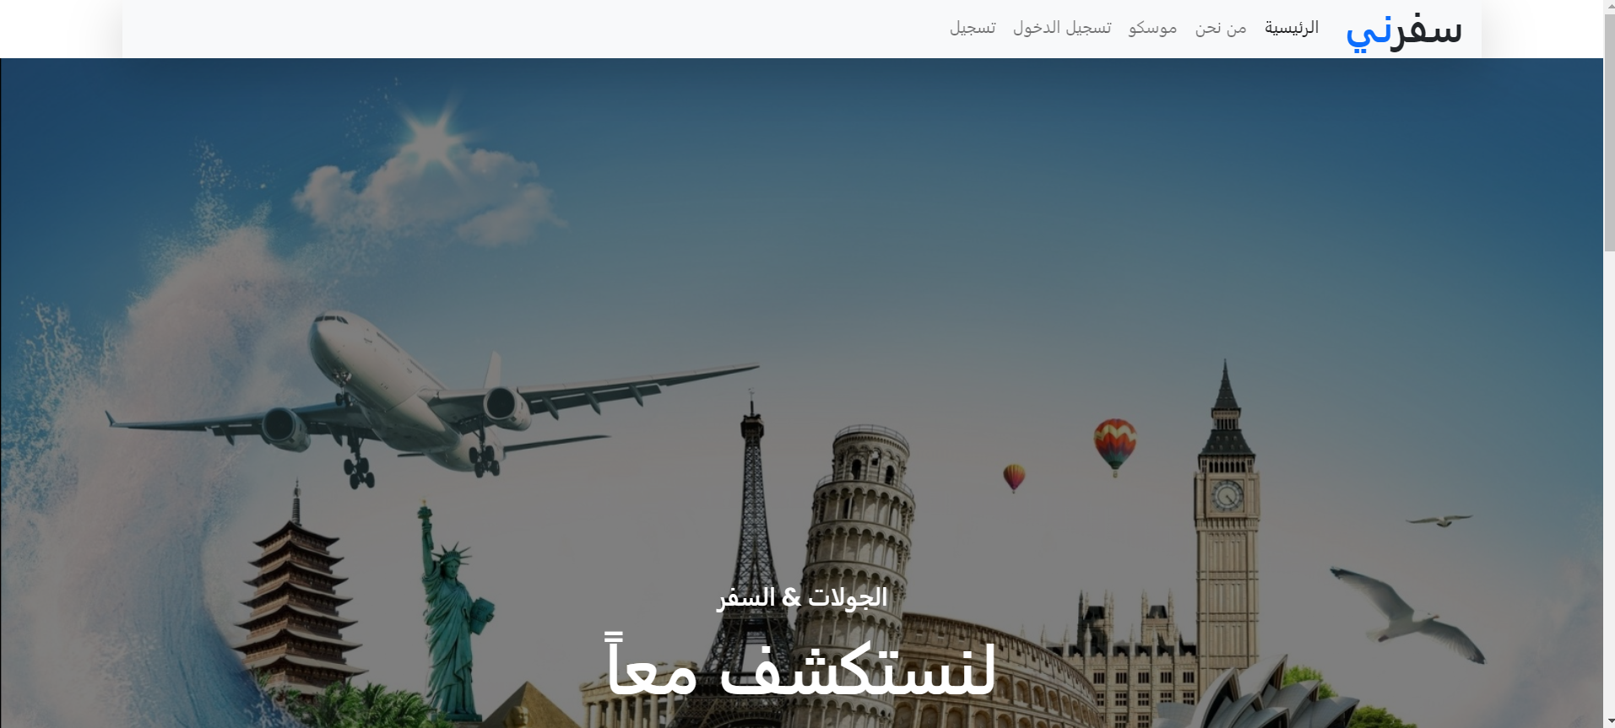
Home Pgae
The home page consist of slide show with a traveling photos and A small overview of the site

Slide 7

02
About us
Motivation and about safirni

Slide 8
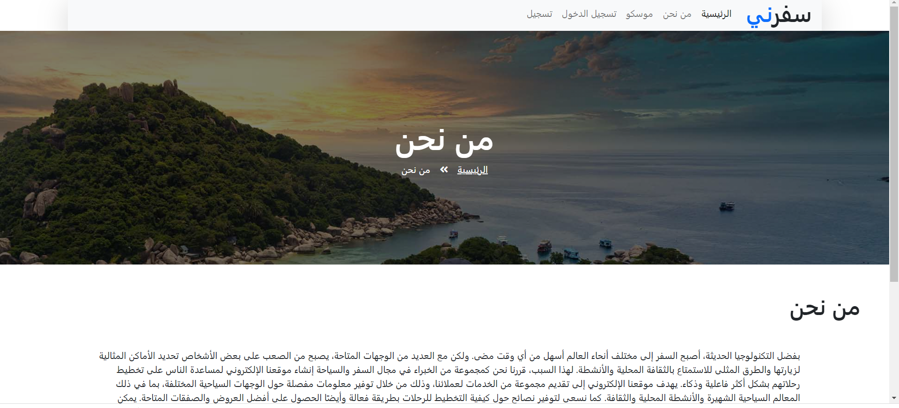
About us
The motivation and what is the goals and who we are

Slide 9
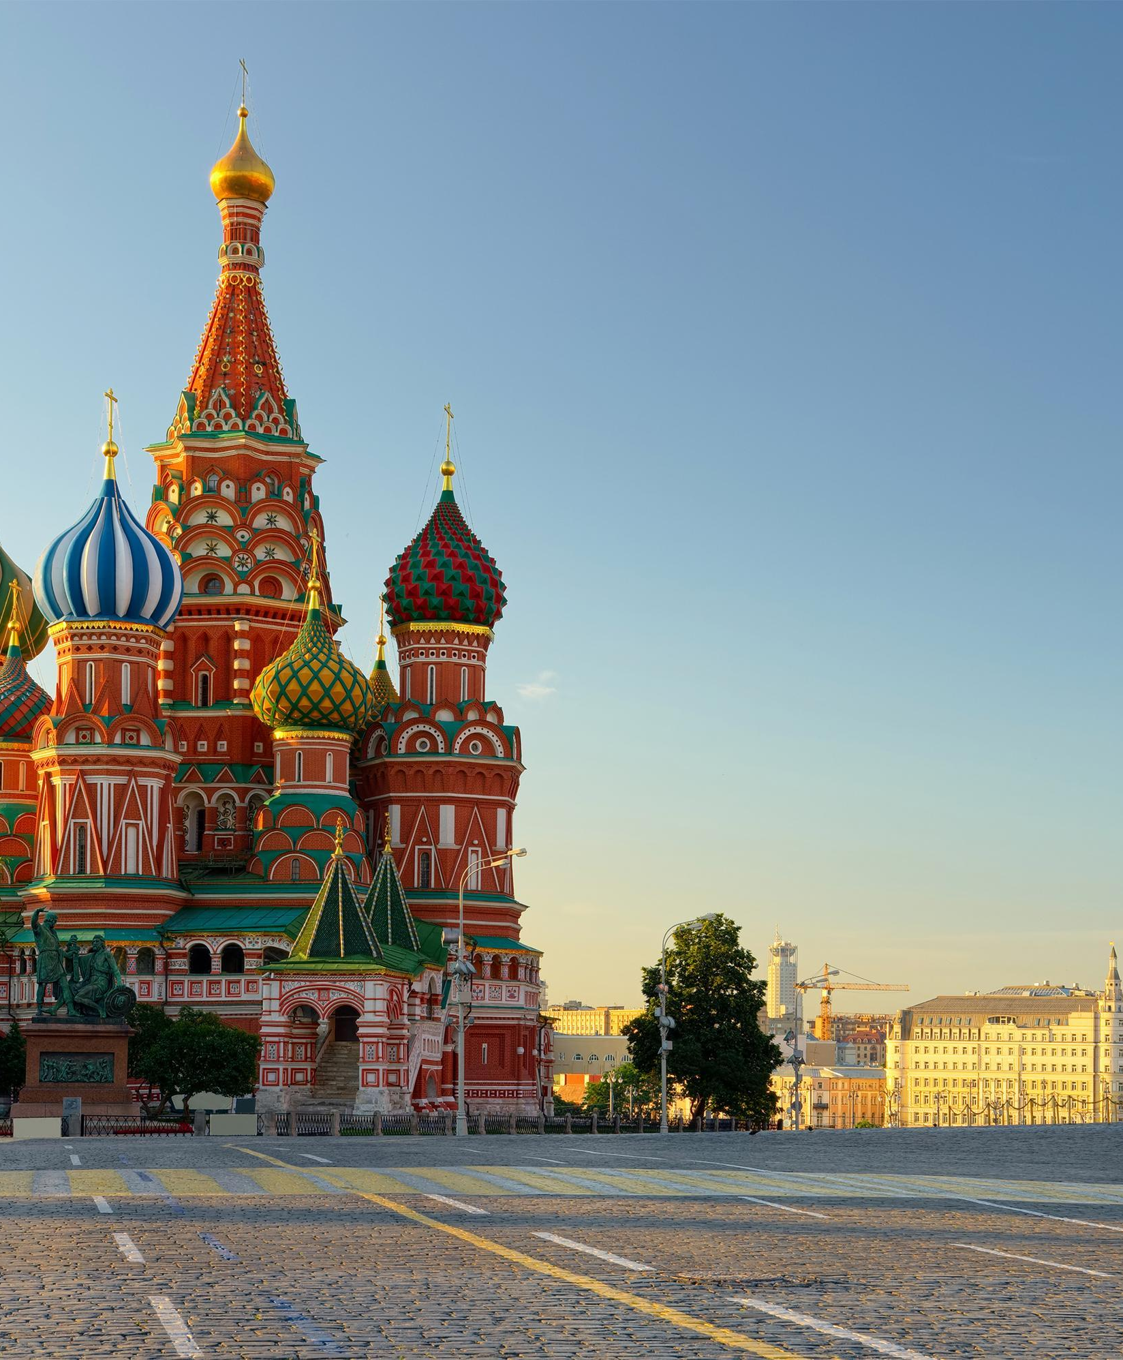
O3
Countries
We took for example Russia / Moscow

Slide 10
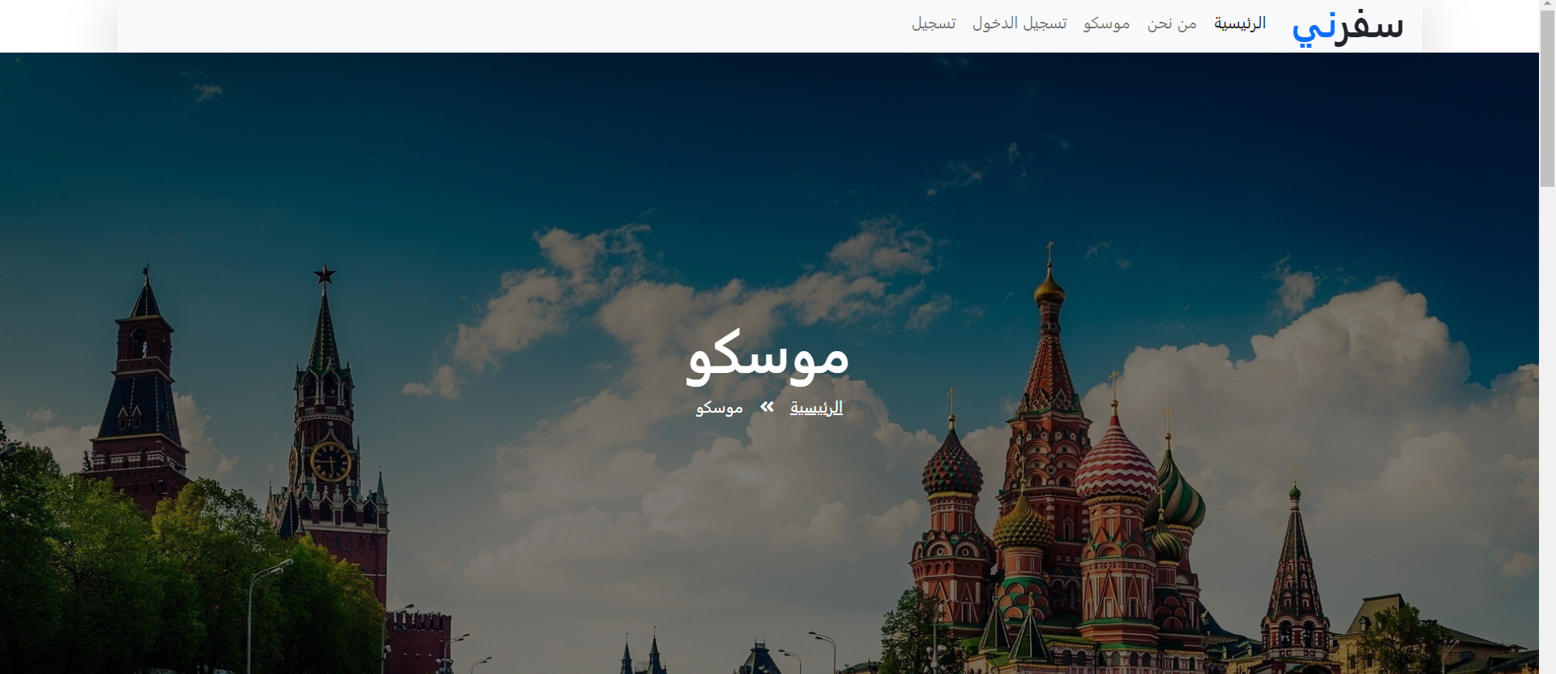
Moscow
Here’s the home page of the city and some pics of the most important culture

Slide 11
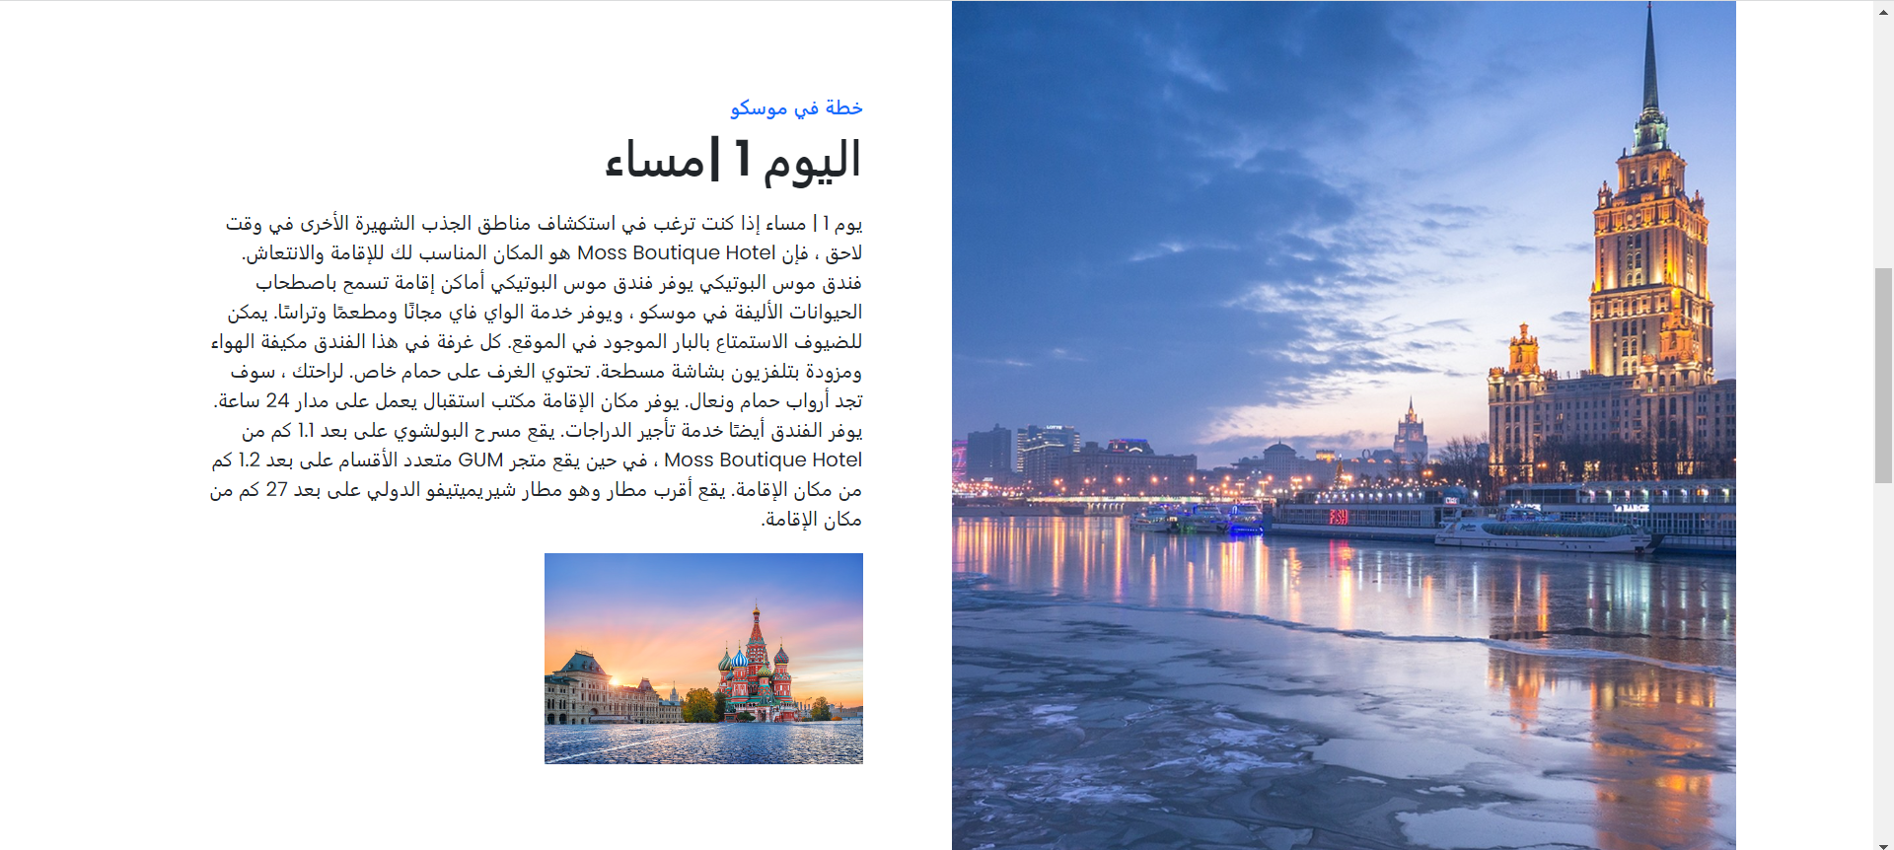
First day plan
Now here’s the plan for the first day contains which hotels are the best and where to go and eat a full plan for the first day

Slide 12
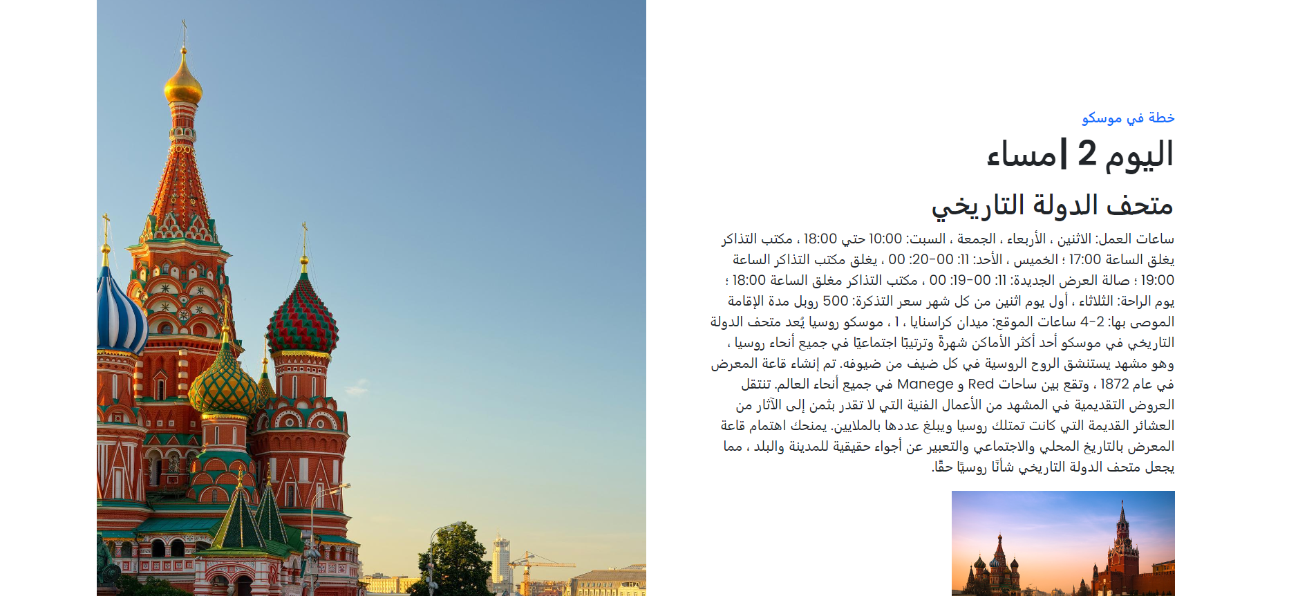
Second day plan
This is the second day of the plan to maximum benefit

Slide 13
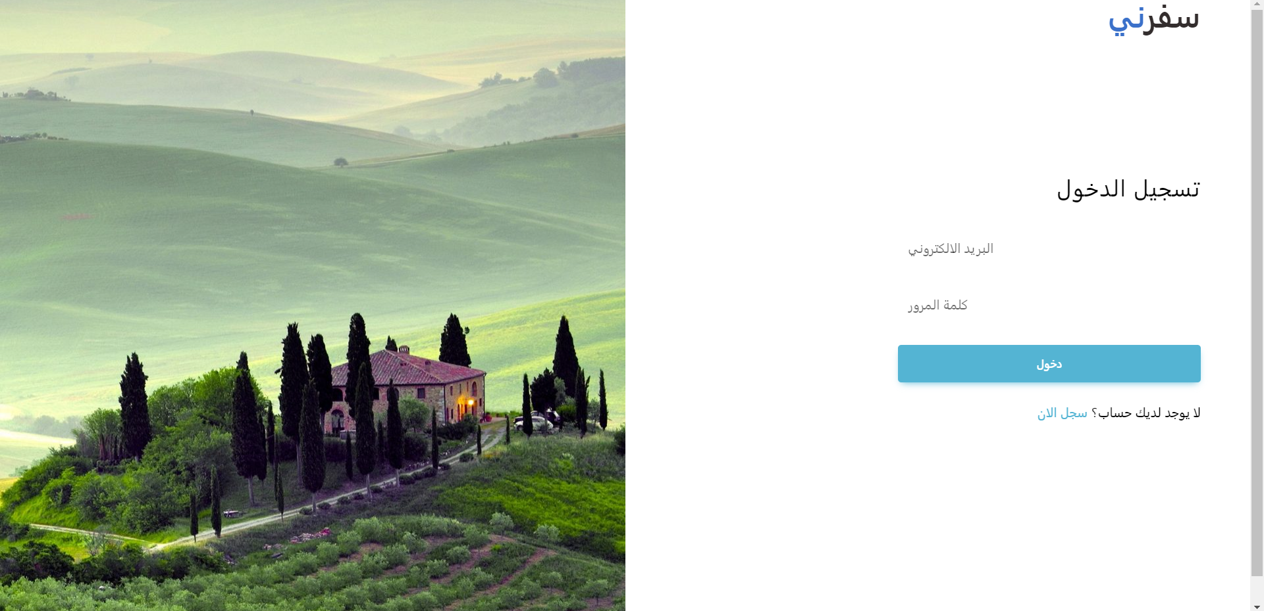
Login
The system ask you to enter your email and password to login as a member of Safirni .
This page well animated

Slide 14
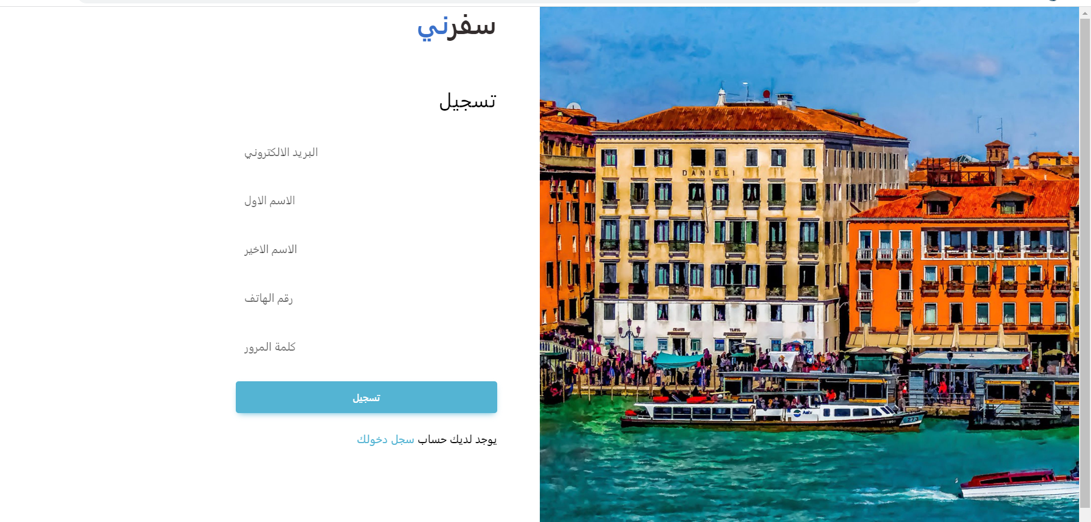
Registration
The system ask the user to enter the email , first name , second name , phone number and password to be a member of safirni
This page well animated

Slide 15
Libraries used and tech
Techs used : 1-HTML
2-CSS
3-JavaScript
Libraries used : 1-googleapis
2- bootstrap
3-owl
4-font-awesome
5- MDB

